Slide 3
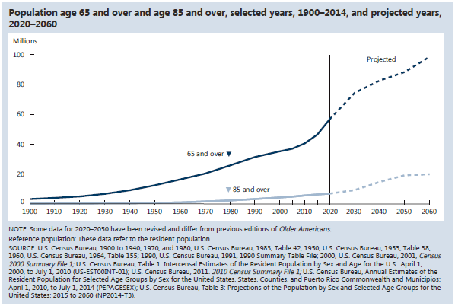
INDICATOR 1: Number of Older Americans

Slide 4
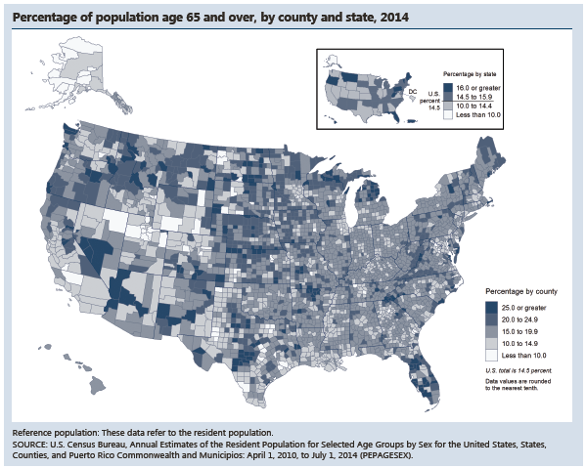
INDICATOR 1: Number of Older Americans (continued)

Slide 5
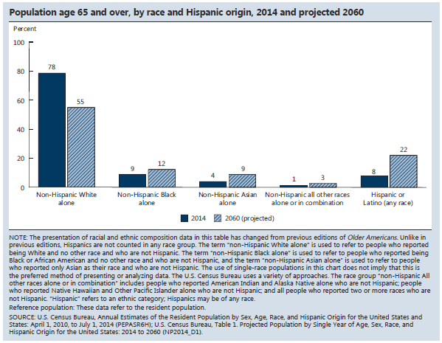
INDICATOR 2: Racial and Ethnic Composition

Slide 6
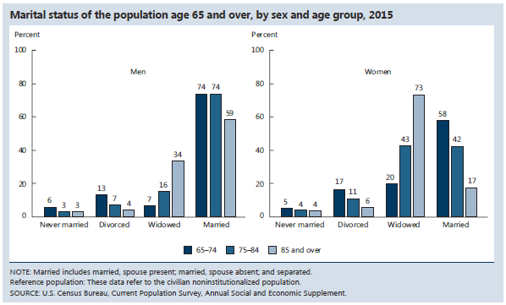
INDICATOR 3: Marital Status

Slide 7
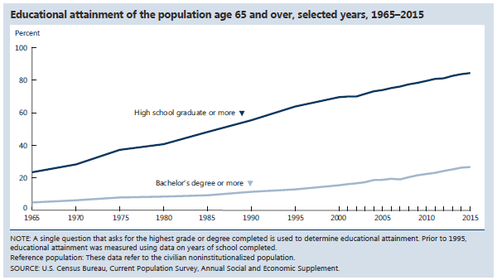
INDICATOR 4: Educational Attainment

Slide 8
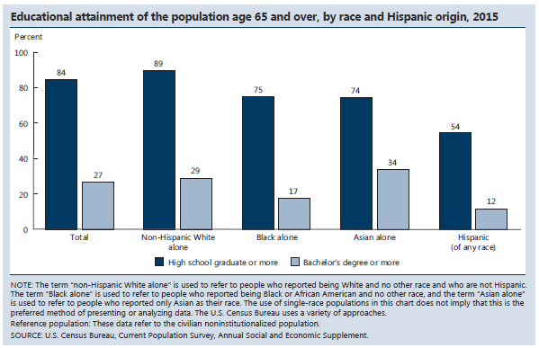
INDICATOR 4: Educational Attainment (continued)

Slide 9
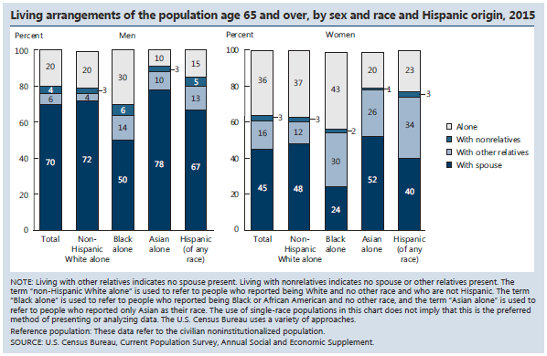
INDICATOR 5: Living Arrangements

Slide 10
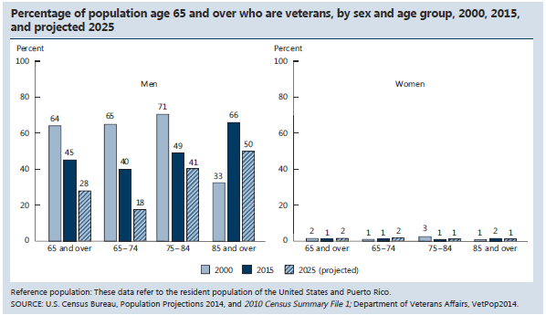
INDICATOR 6: Older Veterans

Slide 12
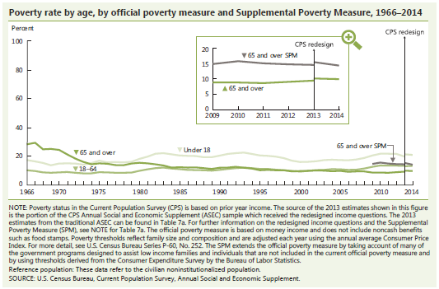
INDICATOR 7: Poverty

Slide 13
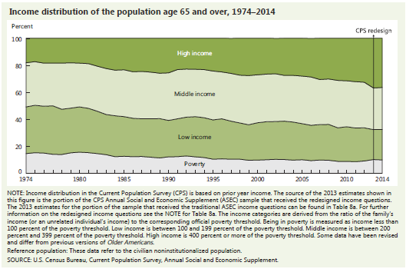
INDICATOR 8: Income

Slide 14
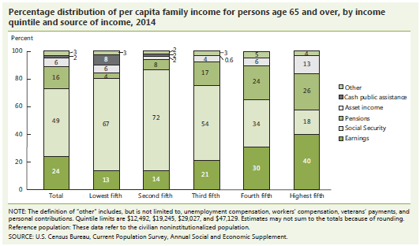
INDICATOR 9: Sources of Income

Slide 15
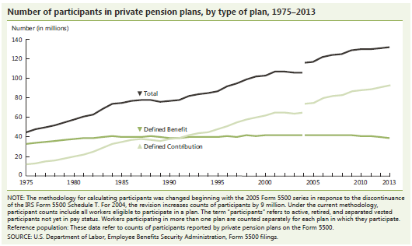
INDICATOR 9: Sources of Income (continued)

Slide 16
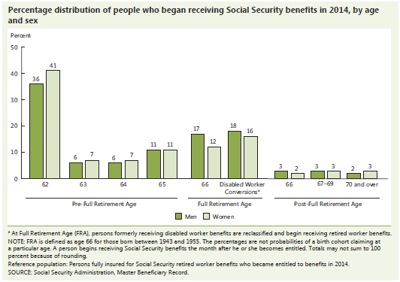
INDICATOR 10: Social Security Benefits

Slide 17
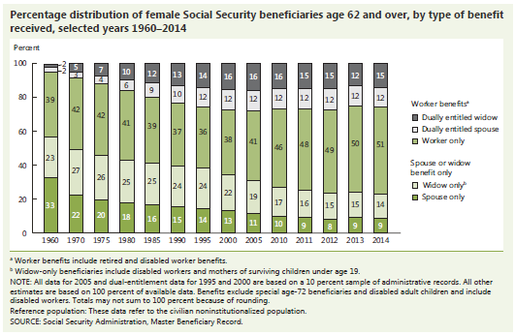
INDICATOR 10: Social Security Benefits (continued)

Slide 18
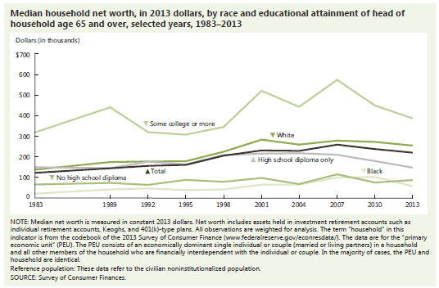
INDICATOR 11: Net Worth

Slide 19
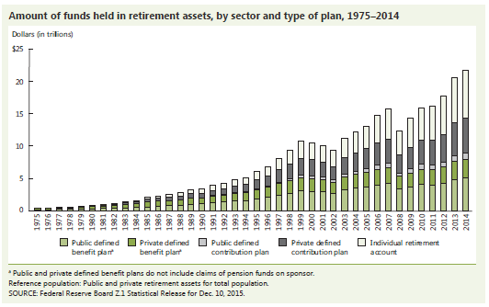
INDICATOR 11: Net Worth (continued)

Slide 20
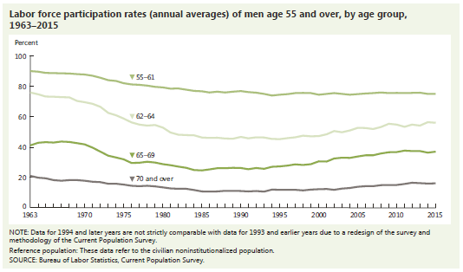
INDICATOR 12: Participation in Labor Force

Slide 21
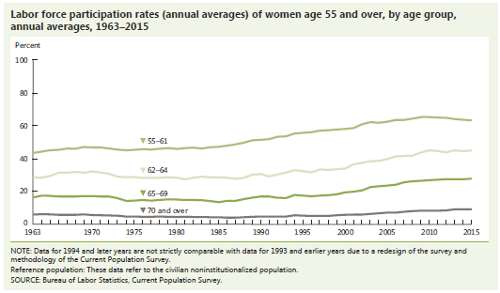
INDICATOR 12: Participation in Labor Force (continued)

Slide 22
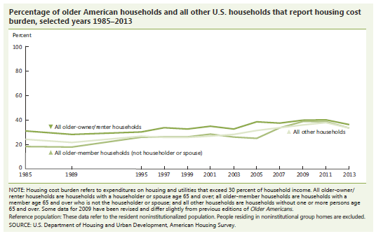
INDICATOR 13: Housing Problems

Slide 23
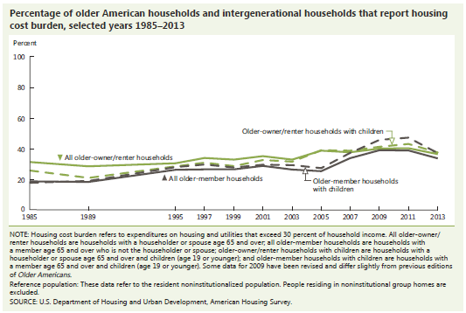
INDICATOR 13: Housing Problems (continued)

Slide 24
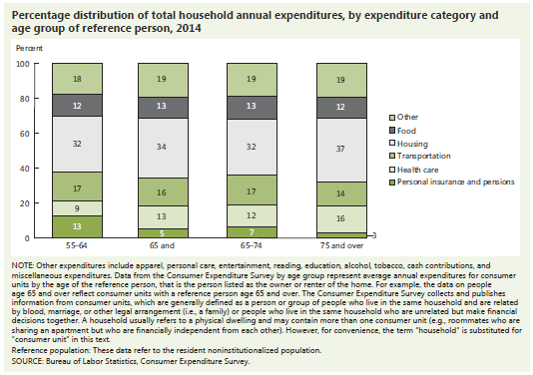
INDICATOR 14: Total Expenditures

Slide 26
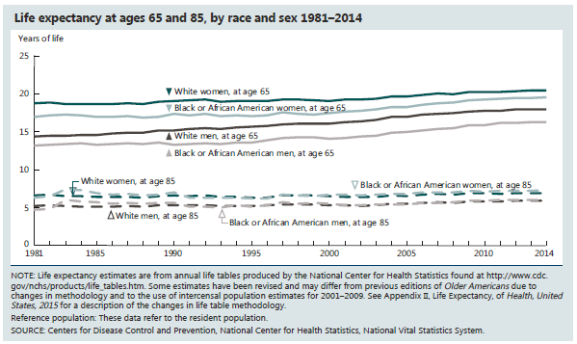
INDICATOR 15: Life Expectancy

Slide 27
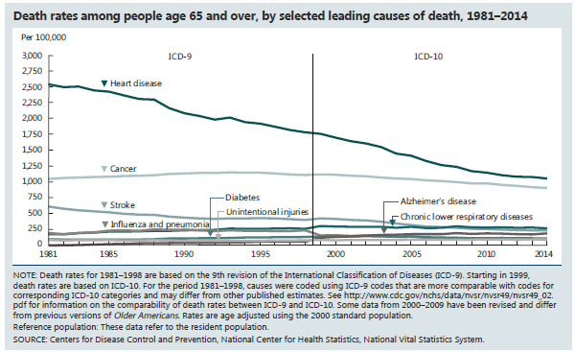
INDICATOR 16: Mortality

Slide 28
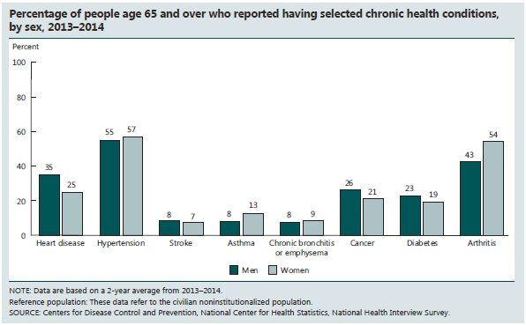
INDICATOR 17: Chronic Health Conditions

Slide 29
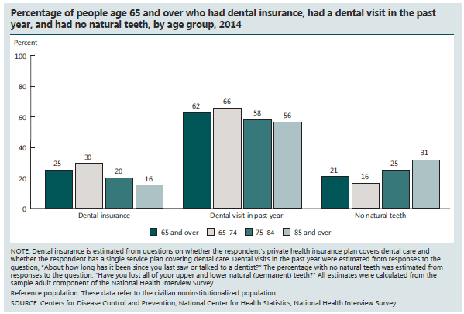
INDICATOR 18: Oral Health

Slide 30
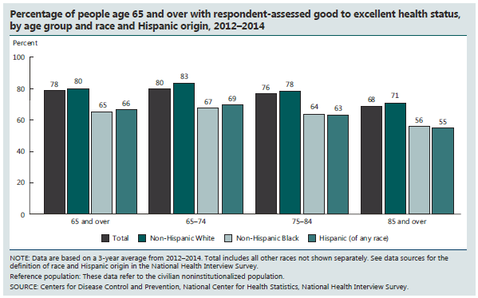
INDICATOR 19: Respondent-Assessed Health Status

Slide 31
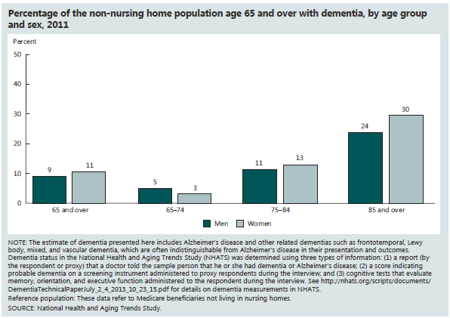
INDICATOR 20: Dementia

Slide 32
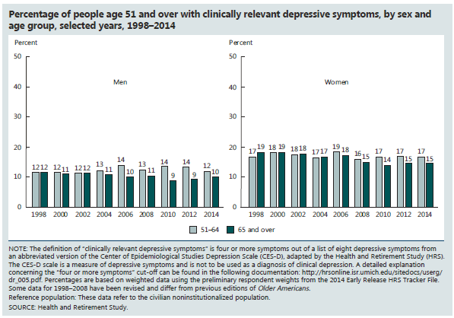
INDICATOR 21: Depressive Symptoms

Slide 33
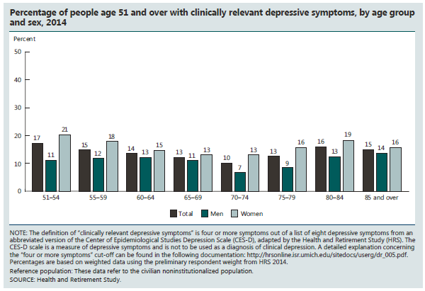
INDICATOR 21: Depressive Symptoms (continued)

Slide 34
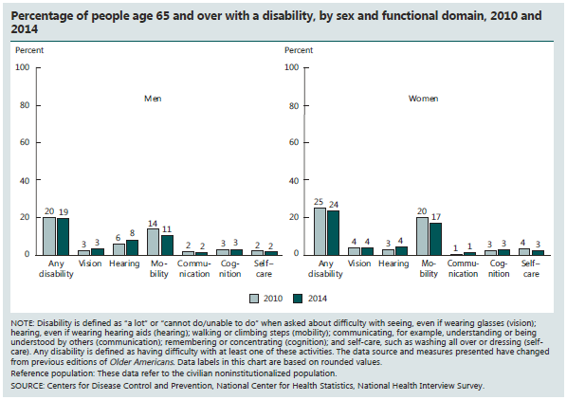
INDICATOR 22: Functional Limitations

Slide 35
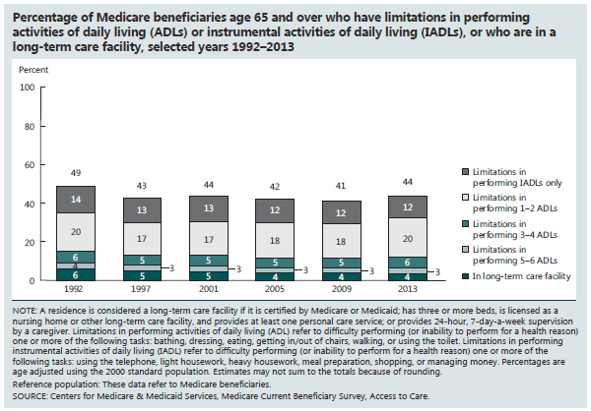
INDICATOR 22: Functional Limitations (continued)

Slide 37
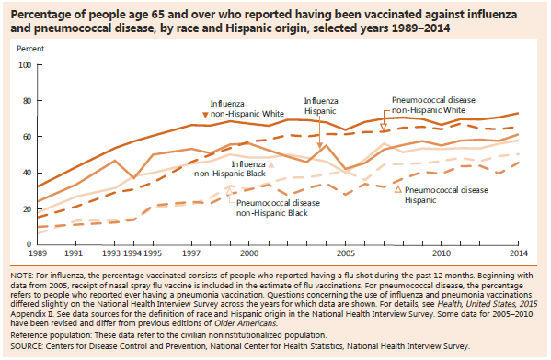
INDICATOR 23: Vaccinations

Slide 38
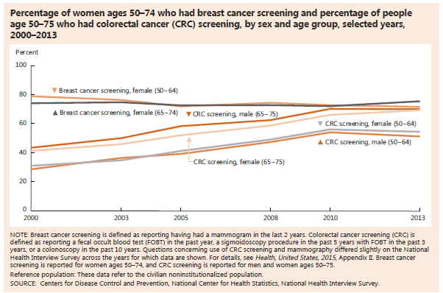
INDICATOR 24: Cancer Screenings

Slide 39
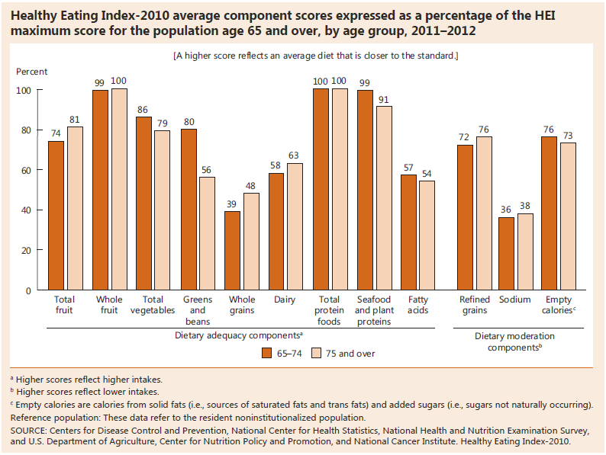
INDICATOR 25: Diet Quality

Slide 40
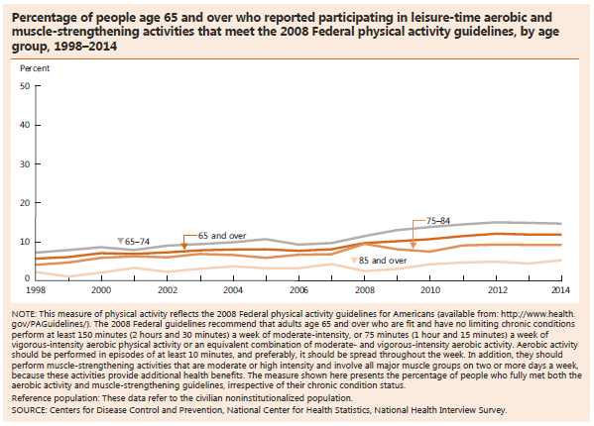
INDICATOR 26: Physical Activity

Slide 41
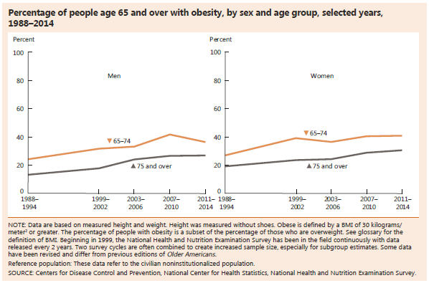
INDICATOR 27: Obesity

Slide 42
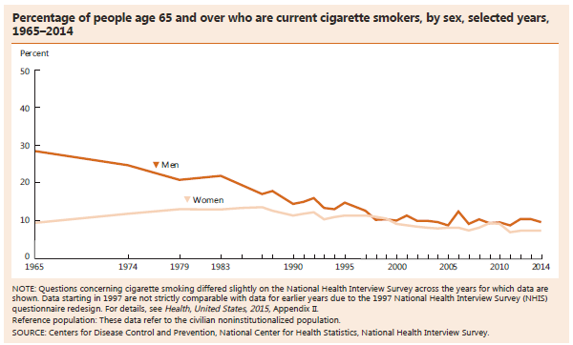
INDICATOR 28: Cigarette Smoking

Slide 44
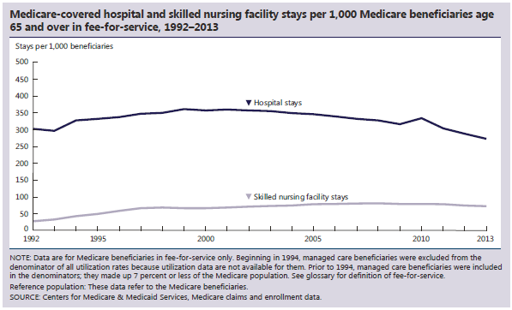
INDICATOR 29: Use of Health Care Services

Slide 45
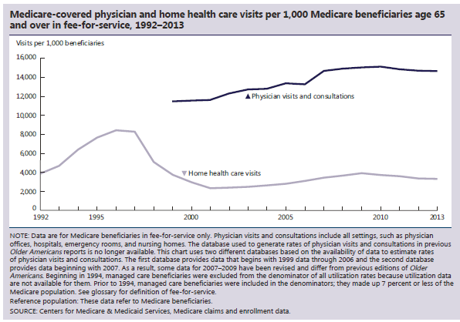
INDICATOR 29: Use of Health Care Services (continued)

Slide 46
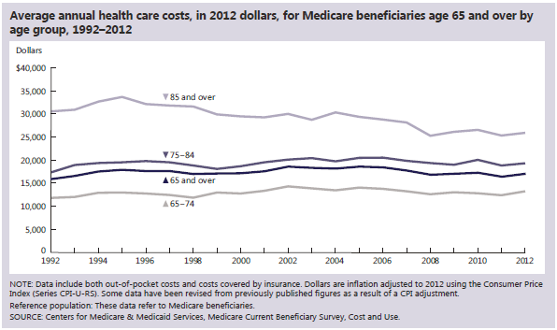
INDICATOR 30: Health Care Expenditures

Slide 47
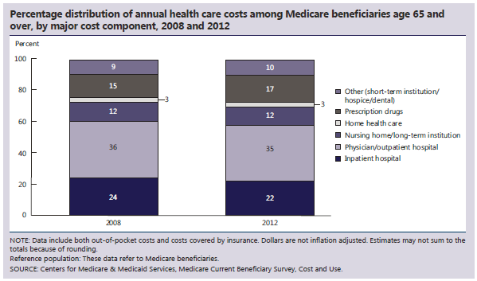
INDICATOR 30: Health Care Expenditures (continued)

Slide 48
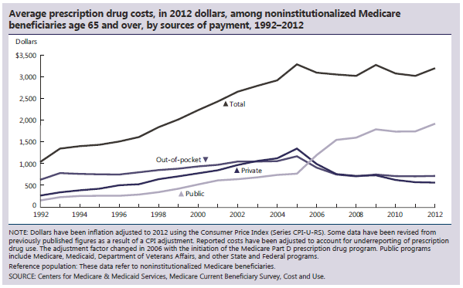
INDICATOR 31: Prescription Drugs

Slide 49
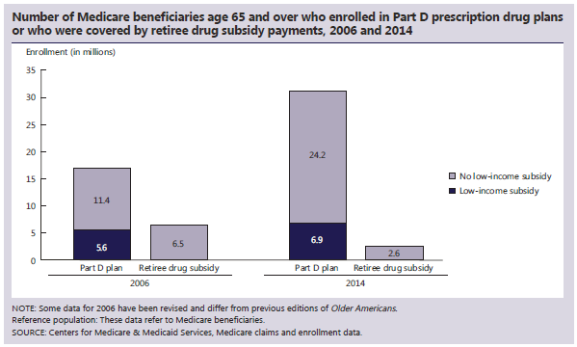
INDICATOR 31: Prescription Drugs (continued)

Slide 50
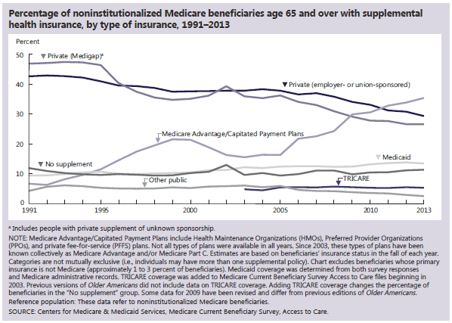
INDICATOR 32: Sources of Health Insurance

Slide 51
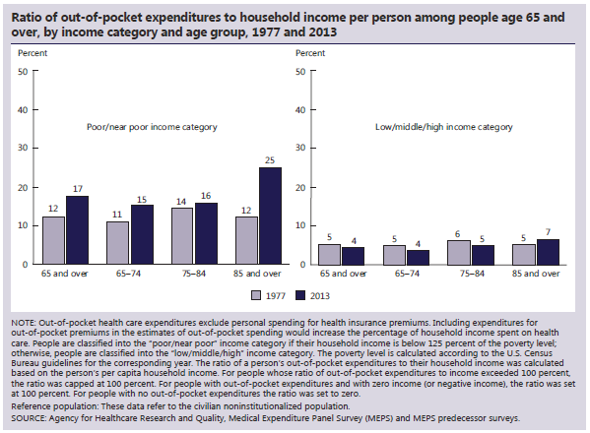
INDICATOR 33: Out-of-Pocket Health Care Expenditures

Slide 52
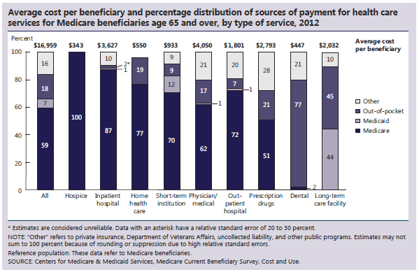
INDICATOR 34: Sources of Payment for Health Care Services

Slide 53
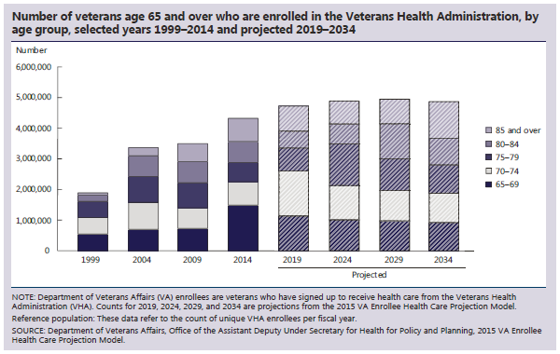
INDICATOR 35: Veterans’ Health Care

Slide 54
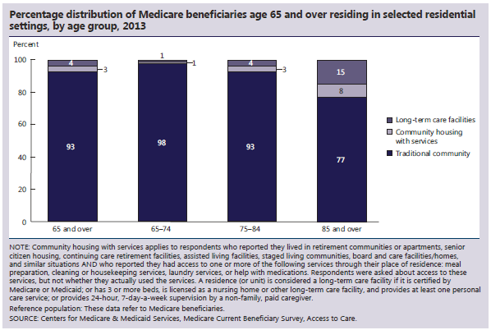
INDICATOR 36: Residential Services

Slide 55
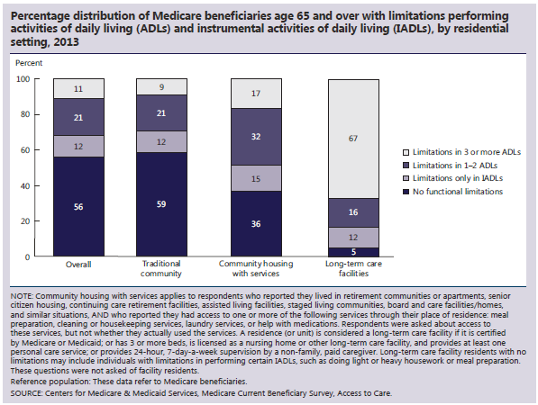
INDICATOR 36: Residential Services (continued)

Slide 56
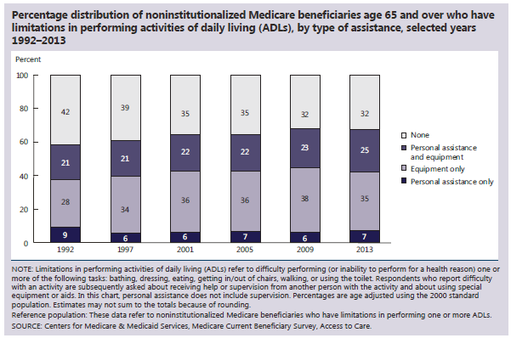
INDICATOR 37: Personal Assistance and Equipment

Slide 57

INDICATOR 37: Personal Assistance and Equipment (continued)

Slide 58

INDICATOR 38: Long-Term Care Providers

Slide 59

INDICATOR 38: Long-Term Care Providers (continued)

Slide 61

INDICATOR 39: Use of Time

Slide 62

INDICATOR 39: Use of Time (continued)

Slide 63

INDICATOR 40: Air Quality

Slide 64

INDICATOR 40: Air Quality (continued)

Slide 65

INDICATOR 41: Transportation

Slide 67

Special Feature: Informal Caregiving

Slide 68

Special Feature: Informal Caregiving (page 2)

Slide 69

Special Feature: Informal Caregiving (page 3)

Slide 70

Special Feature: Informal Caregiving (page 4)

